Slide 1

Women Essentials
Harshal Raikwar

Slide 2

PROBLEM STATEMENT
Health needs and services for various populations have come to the forefront as states work to make their systems more efficient and consider covering additional people under federal health reform implementation. Women, who are key in maintaining healthy families, access the health system more than men, both for themselves and on behalf of their children. Many become pregnant and give birth, a significant health event, then typically become their child’s primary caregiver, a role that greatly influences household health overall.

Slide 3

Business Case
The web application (Women Essentials) is a one stop location to discuss about different medical milestones, AI Disease prediction system, and finally a translator to get the whole web app in the language one is comfortable with and hence dissolve any communication barrier. This solution with shorten the gap between the people around the world in search for good healthcare and pave a path in the journey of recovery. The web application offers different types of disease detection such as Heart Disease, Kidney disease etc. for early detection of the disease.

Slide 4
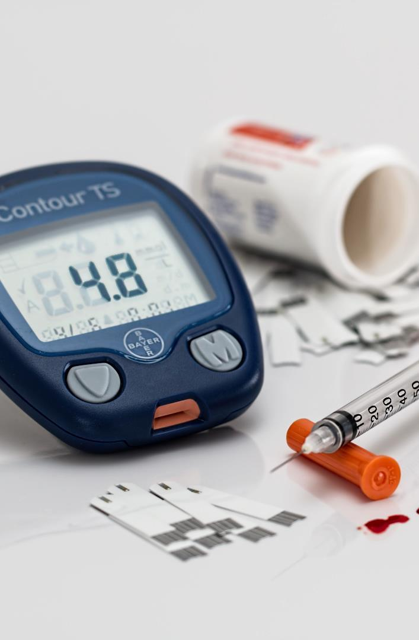
FUNCTIONAL REQUIREMENTS
1)Functional Requirements:
Registration -> The customer needs to be registered first to use the system. The input of this function will be details about the customer such as email and password to be created by the customer for future login. The information will be stored in database.
Login -> Every time for accessing the system username and password will be required by this function from the customer. If the customer enters invalid details, the message will be displayed as "Invalid username/password".
Doctor Appointment -> User can book an appointment with doctor through the portal.
Disease prediction -> User can use various types of disease prediction to predict whether he/she is infected with one or not.
Chatbot -> User can use the smart chatbot for his/her assistance.

Slide 5
NON FUNCTIONAL REQUIREMENTS
2. Non Functional Requirements :
Security -> Security is very important in this system firstly to make sure that the product reaches the customer and no one other gets access. The security of the user's account is also important so that the information about the products purchased is kept secured and no person can order something from other's account.
Availability of doctors-> The availability of the doctor should be there so that the users can fix their appointment easily.
Punctuality -> Punctuality is required so that users can get their appointment on time. This builds trust between the user and the system.
Conveniency -> The system should be convenient in terms of users' communication with all aspects of the system. There should be no complexity in any of the functions required from the customer.
Reliability -> Reliability is proportional to the amount of errors or failures the system faces while being used. The failures should be minimum while users perform any actions. If there is any failure, the customers should be provided with the solution quickly and easily. Every problem which may occur should be identified from before and a solution should be kept from before. This all entrusts the customer with our system.
Good User-Interface -> The user interface of the application should be seamless and easy for the customers to use so that anybody can access everything in the system fast and conveniently.

Slide 6
INFRASTRUCTURE REQUIREMENTS
3. Infrastructure Requirements :
I. Hardware Requirements:-
Standard PC with Windows or Mac OS
Mobile (IOS or Android)
Internet Browser
Internet
II. Software Requirements :-
Front - End : React Js, CSS, HTML
Back – End : Flask
Database : Firestore

Slide 7
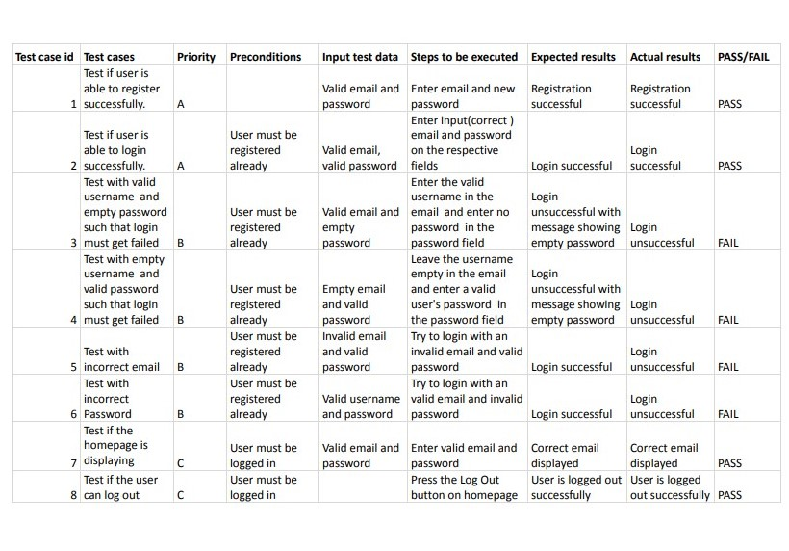
TEST CASE

Slide 8
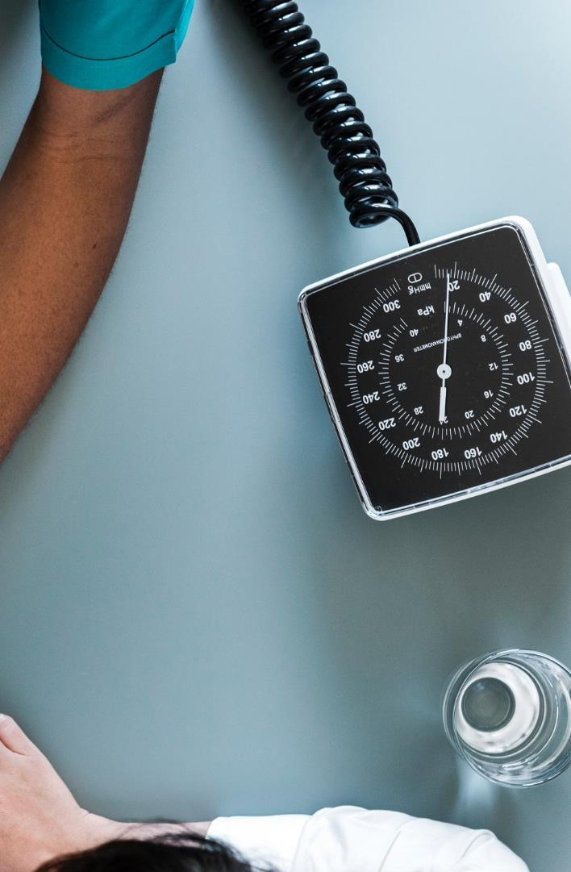




Features
Easy to use
Easy Log In
Easy steps to be followed for keeping track.
It is very easy to login.
Save time
Privacy
As you don’t need to stand and wait you your number for checkup, you can do assessment online.
All the information provided to the application are secured

Slide 9



Thank You
https://github.com/Harshal0902/Women-Essential
https:// womenessentials.herokuapp.com

